Slide 1

Event Driven Architecture SES, SNS & Lambda
2/28/2023

Slide 2

Rules/Code of Conduct
Be respectful: Treat others with kindness and consideration, regardless of differences in opinions, backgrounds, or beliefs.
Communicate effectively: Use clear and concise language when communicating with others and avoid using offensive or derogatory language.
Follow the rules: Adhere to all applicable laws, policies, and guidelines, and seek guidance when in doubt.
Respect the space: Clean up after yourself and return furniture to its original spots.

Slide 3
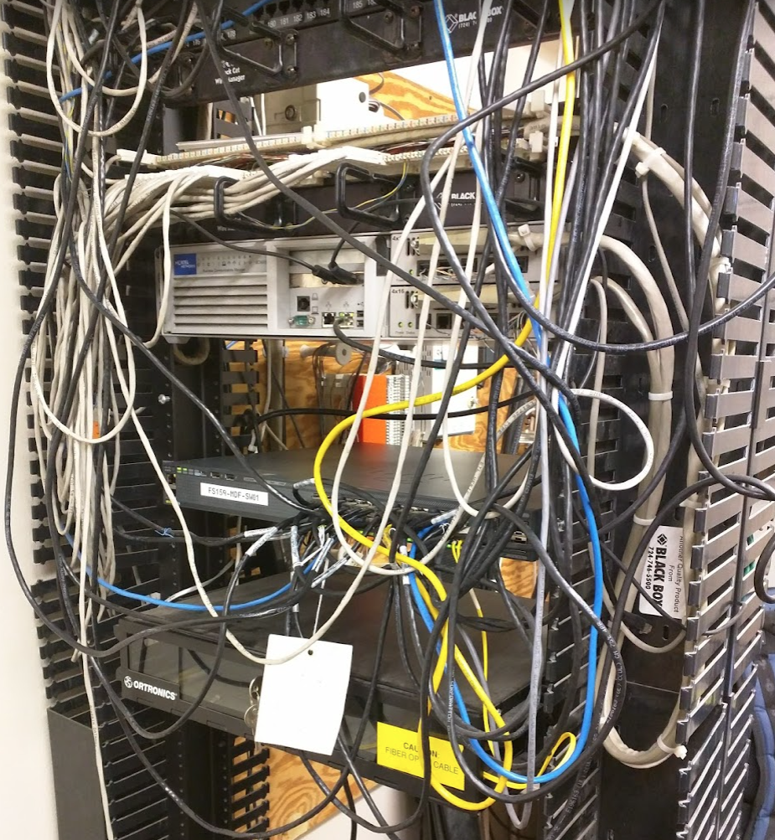
What are we doing here?
Networking
Increased opportunities – not what you know, but who you know.
Staying informed – keeping your finger on the pulse.
Helping others – connecting those in your social circle to the right people.
Collaborating – problem-solving, knowledge sharing.
Socializing – Some people need to talk to other people in the flesh!

Slide 4


Introductions
Trent Nielsen
Title: Enterprise Architect
Company: Parson’s Xtreme Golf

Slide 5


Dirk Arends
Role: Principal Migration Advisor
Company: Amazon Web Services
AJ Tarachanowicz
Role: Software Engineer
Company: Freelance/Independent

Slide 6

Meetup Info
Fourth Tuesday of every Month at 6:00 PM
The Factory
77 Monroe Center St NW Ste 600
Grand Rapids, MI, 49503
Meeting notes/presentation info: https://github.com/tnielsen2/WMAUG-Meetings
Who
What
When
Anything else

Slide 7


Log Ingestion SES, SNS and Lambda

Slide 8
What is DBT Cloud?
DBT Cloud is a cloud-based platform that provides data analysts and engineers with a modern, collaborative, and automated environment for building, testing, deploying, and managing data transformations using the popular open-source tool, dbt (data build tool).
DBT Cloud is a closed system and a somewhat new SaaS offering to abstract the pain from running dbt on-premise, while also placing the responsibility of the data into the hands of data engineers.

Slide 9
What is Datadog?
Datadog is a cloud-based monitoring and analytics platform that provides real-time visibility into the performance of IT infrastructure, applications, and logs. It is used by organizations to monitor and troubleshoot their systems and applications, and to gain insights into the health and performance of their entire stack.
It is used to monitor and alert all of our teams of performance, status and infrastructure failures.

Slide 10
Use Case?
DBT Cloud does not have Datadog log integration
Logging exists within their cloud ecosystem
No webhook capability (at the time of engineering this solution)
Has enough API capability to extract logs
DBT Cloud runs on branch commit, and scheduled jobs.
Email notification only notifies user’s email addresses of failure.
How do we notify an entire team?
No one can watch email 24/7
Slack integration only notifies a channel of failure.
No one can watch Slack 24/7
PagerDuty notifications are required for:
Degradation of service
Failures
Long-running jobs

Slide 11

Pull/Push Logs via API
DBT Support recommended using the API
Python
DBT Cloud has first party support for Python PIP
Datadog has first party support for Python PIP
Data team uses python-based tools (MWAA)
SRE uses Python-based tools (Homegrown CloudFormation and Ansible tools)

Slide 12

Ideas/methods
Trigger upon webhook by CI
Doesn’t account for scheduled jobs
Trigger Lambda from CI scheduled job w/ cron (Actions or Jenkins)
Developers do not want to commit to more files ”outside the DBT Cloud ecosystem”
Requires knowledge and education from Ops on GitHub actions scheduled jobs
Eventbridge rules to trigger Lambda
Too labor intensive/complicated to sync triggers with jobs
Slack Workbooks
DBT Cloud has Slack notifications, but we haven’t used workbooks in the past
Email triggered ingestion
Maybe?

Slide 13
Considerations
Must be scalable to hundreds of jobs.
How long does the execution of log ingestion take?
Email or Slack are the only methods of job notification status.
How can we monitor this log ingestion app?
Datadog logging must be in JSON format for easy transformation.

Slide 14
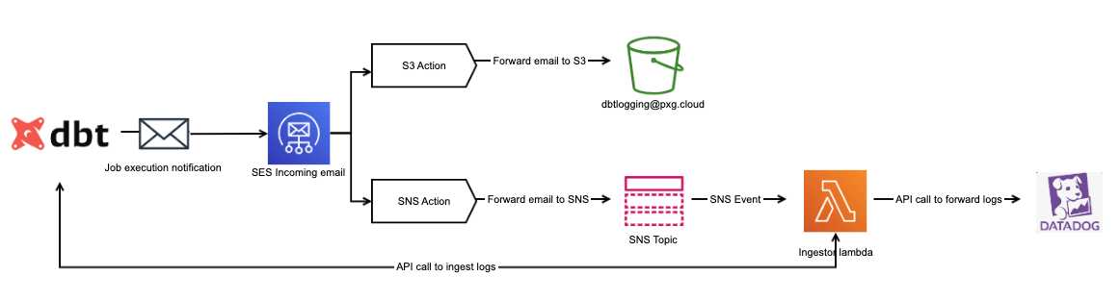
Solution
Email driven architecture
SES – Process incoming email
SNS – Queue email message body into queue that is readable
Lamba – Parse email body, pull and push logs.

Slide 15
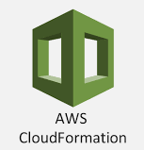
CloudFormation Implementation
IAM:
lambdaRole: Role – reading secrets for API keys as environment variables
Lambda:
dbtLogIngestor: Function – the code that executes the extraction
dbtLogIngestorAlias: Alias – latest alias that SNS points to.
dbtPipLayer: LayerVersion – Layer containing DBT Cloud and Datadog packages.
snsTriggerPermission: Permission – Permission for SNS cloud service to trigger code.
SNS:
snsTopic: Topic – Topic to publish messages to.
snsTopicPolicy: TopicPolicy – Permission to allow SES to publish to the topic.

Slide 16
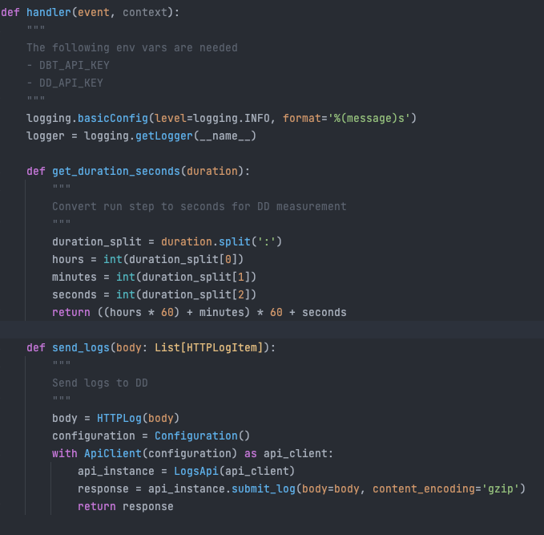
Lambda Code

Slide 17
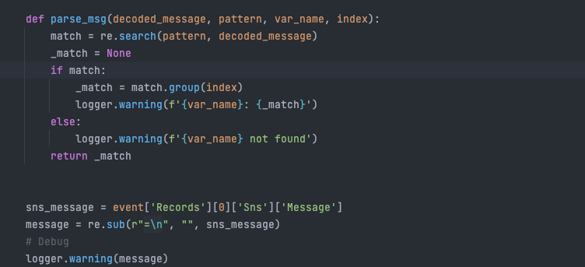
Lambda Code

Slide 18
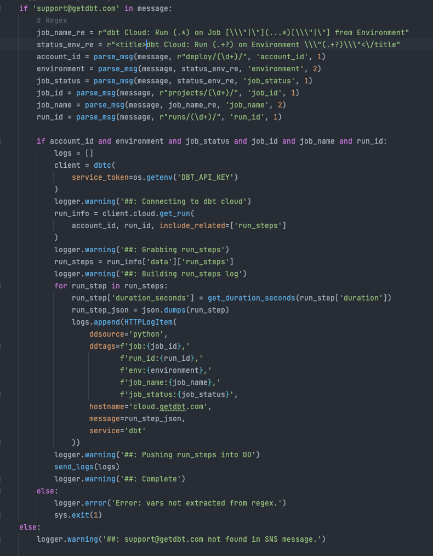
Lambda Code

Slide 19
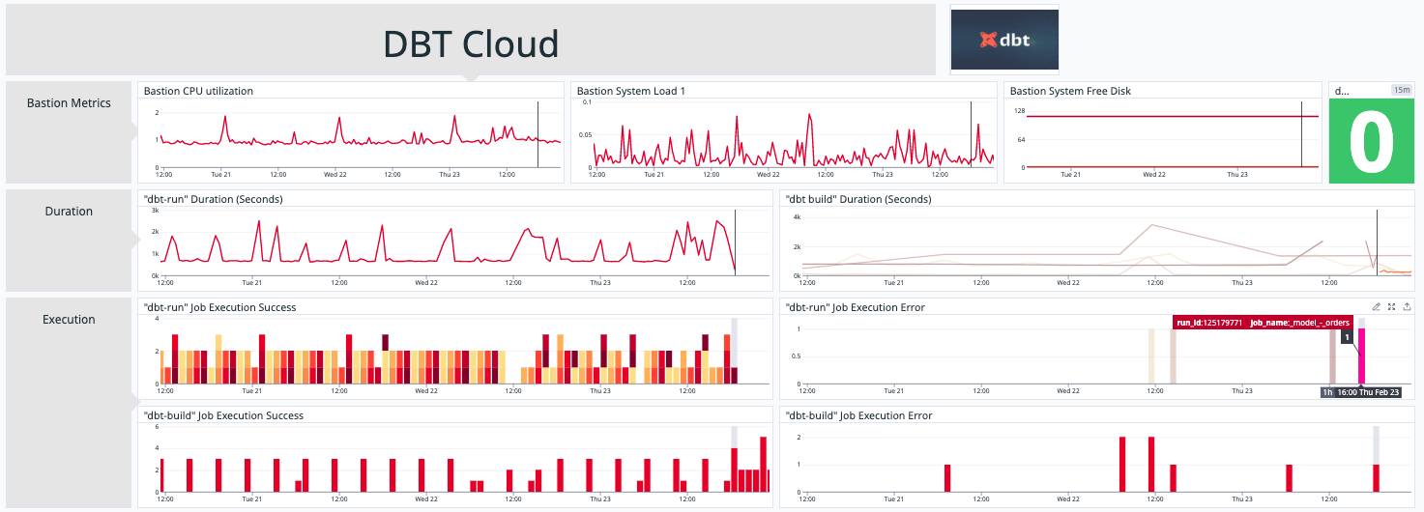
Monitoring and Alerting
Datadog Native AWS integration for log ingestor metrics/failures
Custom metrics created from Datadog Logs
Monitors written from custom metrics.

Slide 20

Questions?

Slide 21
Future topics?
MySQL RDS deployment, configuration and implementation
CloudFormation custom tooling
Transit Gateway implementation within hybrid network
S3 backed static website with content using CloudFront

